Slide 1
IBM University Engagement Project Submission
“Exploring the Power of Agentic AI with IBM “

Slide 2

Project Tile – Agentic AI Health Symptom Checker
Domain of Project – HealthCare
Student Name | Recent Passport Photo | Email ID | Mobile number [WhatsApp]
Shiva Pillai |  | 241b239@juetguna.in | 9179910402

Slide 3
Problem Statement -
Problem Statement : MediGuide AI - Agentic Health Symptom Checker
The Challenge
Access to reliable health information remains a challenge for many individuals. People often struggle to understand symptoms, assess their severity, and determine when medical attention is necessary. Health information is scattered across websites, forums, and social media, leading to misinformation and delayed healthcare decisions. Without personalized, real-time guidance, users may overlook important symptoms or engage in unsafe self-diagnosis.
The Objective
Build an AI-powered Health Symptom Checker that provides personalized health insights and guidance using trusted medical sources. The solution should:
• Symptom Analysis – Understand symptoms described in natural language and identify possible health conditions.
• Medical Knowledge RAG Retrieval – Retrieve verified information from WHO guidelines, government health portals, and trusted medical references.
• Urgency Assessment – Classify symptom severity as Low, Medium, or High and recommend appropriate next steps.
• Preventive Health Guidance – Provide self-care recommendations, preventive measures, and wellness tips.
• Multi-Language Support – Enable users to interact in multiple languages for greater accessibility.
• Agentic AI System – Coordinate multiple AI capabilities to retrieve, analyze, and explain health information.
• Health Knowledge Agent – Fetch trusted medical information and guidelines.
• Symptom Assessment Agent – Analyze symptoms and identify possible causes.
• Health Advisory Agent – Provide preventive care recommendations and healthcare guidance.
• Emergency Detection Agent – Detect warning signs and recommend immediate medical attention when necessary.
• Health Insights Dashboard – Display symptom history, health trends, and personalized recommendations.
Expected Outcome
MediGuide AI will empower users with trustworthy health information, promote early awareness of potential health conditions, reduce misinformation, and encourage timely consultation with healthcare professionals while avoiding self-diagnosis risks.

Slide 4
Technology Used
Technology Used
Tech Stack (Mandatory)
The solution is developed using the following technologies:
• IBM watsonx Orchestrate – Agent orchestration, workflow management, and intelligent decision-making.
• IBM watsonx.ai – Large Language Model (LLM) capabilities for symptom understanding, reasoning, and response generation.
• GPT-OSS 120B Model – Natural language processing, health query analysis, and conversational interactions.
• Retrieval-Augmented Generation (RAG) – Retrieves trusted medical information from uploaded health documents and knowledge sources.
• Knowledge Base – WHO guidelines, government health resources, first-aid manuals, and verified medical references.
• IBM Cloud Lite Services – Cloud hosting and deployment environment.
• HTML, CSS, JavaScript – User interface and web application development.
Architecture
User → MediGuide AI Interface → IBM watsonx Orchestrate → GPT-OSS 120B → RAG Knowledge Base → Health Guidance & Recommendations
Key Technologies
✓ IBM watsonx Orchestrate ✓ IBM watsonx.ai ✓ GPT-OSS 120B ✓ RAG (Retrieval-Augmented Generation) ✓ IBM Cloud Lite ✓ HTML/CSS/JavaScript

Slide 5
Proposed Solution -
Proposed Solution: MediGuide AI - Agentic Health Symptom Checker
The proposed solution is a multi-agent AI-powered Health Symptom Checker built using IBM watsonx Orchestrate, IBM watsonx.ai, GPT-OSS 120B, and Retrieval-Augmented Generation (RAG) to provide reliable and personalized health guidance. The system helps users understand symptoms, assess health risks, and make informed healthcare decisions through an intelligent agentic architecture.
At its core, the solution uses a RAG pipeline to retrieve accurate medical information from trusted sources such as WHO guidelines, government health portals, first-aid manuals, and verified medical references. This information is embedded and stored in a knowledge base, enabling the system to retrieve relevant health information and generate evidence-based responses.
The system consists of four key agents:
Health Knowledge Agent retrieves and summarizes trusted medical information using RAG.
Symptom Assessment Agent analyzes user symptoms and identifies possible health conditions and severity levels.
Health Advisory Agent provides preventive care recommendations, self-care guidance, and wellness suggestions.
Emergency Detection Agent identifies critical symptoms and recommends immediate medical attention when necessary.
The solution includes a user-friendly web interface where users can describe symptoms in natural language and receive instant health insights. The platform supports multilingual interactions and provides urgency assessments, health recommendations, and trusted educational information.
IBM watsonx Orchestrate is used to coordinate agent workflows and decision-making, while IBM watsonx.ai and GPT-OSS 120B provide advanced reasoning, language understanding, and response generation capabilities.
Overall, MediGuide AI delivers an end-to-end intelligent health assistance system that promotes early health awareness, reduces misinformation, encourages timely medical consultation, and empowers users with trustworthy health guidance. 🩺🤖

Slide 6
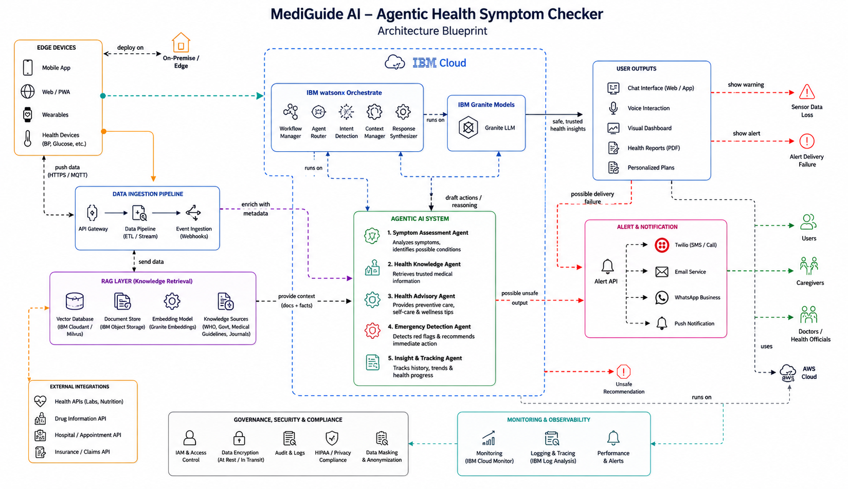
Architecture blueprint

Slide 7
Embed on your website
<script> window.wxOConfiguration = { orchestrationID: "3ec4d8c27f8d423eb5a89eb6e2b97585_cfe7047f-e2c1-4307-813b-a0b8835f1440", hostURL: "https://au-syd.watson-orchestrate.cloud.ibm.com", rootElementID: "root", deploymentPlatform: "ibmcloud", crn: "crn:v1:bluemix:public:watsonx-orchestrate:au-syd:a/3ec4d8c27f8d423eb5a89eb6e2b97585:cfe7047f-e2c1-4307-813b-a0b8835f1440::", chatOptions: { agentId: "c2dd865e-12b4-486b-a45d-bfdb460abfe1", } }; setTimeout(function () { const script = document.createElement('script'); script.src = `${window.wxOConfiguration.hostURL}/wxochat/wxoLoader.js?embed=true`; script.addEventListener('load', function () { wxoLoader.init(); }); document.head.appendChild(script); }, 0); </script>

Slide 8

Role of Agentic AI in the solution
Role of Agentic AI in MediGuide AI
Agentic AI is the core intelligence behind MediGuide AI. Instead of simply answering questions, it can understand user symptoms, plan actions, retrieve trusted medical information, reason about possible health conditions, and provide personalized guidance.
Key Roles of Agentic AI
🔹 Symptom Understanding
Interprets symptoms described in natural language.
Extracts important health information from user input.
🔹 Knowledge Retrieval (RAG)
Searches trusted sources such as WHO guidelines, government health portals, and medical documents.
Retrieves relevant medical information before responding.
🔹 Multi-Agent Collaboration
Health Knowledge Agent retrieves medical facts.
Symptom Assessment Agent analyzes symptoms.
Health Advisory Agent provides recommendations.
Emergency Detection Agent identifies critical situations.
🔹 Reasoning and Decision-Making
Evaluates symptom severity.
Determines urgency levels (Low, Medium, High).
Suggests appropriate next actions.
🔹 Personalized Guidance
Provides tailored health advice based on symptoms and context.
Adapts responses to the user's language and needs.
🔹 Safety and Reliability
Avoids self-diagnosis and unsupported medical claims.
Encourages professional medical consultation when necessary.
Uses only trusted and verified health information.

Slide 9
Technology Used
For MediGuide AI, you can use this content for the Technology Used slide:
Technology Used
IBM watsonx Orchestrate - Used to design and coordinate the Agentic AI workflow, manage tasks, and orchestrate interactions between multiple AI agents.
IBM watsonx.ai - Provides AI model deployment, prompt engineering, reasoning capabilities, and AI governance for the solution.
GPT-OSS 120B - Used for natural language understanding, symptom analysis, reasoning, and generating human-like health guidance.
Retrieval-Augmented Generation (RAG) - Retrieves trusted medical information from WHO guidelines, government health portals, and verified medical documents before generating responses.
Knowledge Base (Uploaded Medical Documents) - Stores trusted healthcare resources for accurate and evidence-based information retrieval.
IBM Cloud Lite - Provides a secure, scalable, and reliable cloud environment for deploying and managing the application.

Slide 10
Novelty and Uniqueness
The proposed Nutrition Agent stands out by combining Agentic AI, RAG, and personalization into a single intelligent system.
Multi-Agent Intelligence – Instead of a single chatbot, multiple specialized agents collaborate to deliver accurate and context-aware nutrition guidance.
RAG-Based Accuracy – Integrates real-time data retrieval with AI generation, reducing misinformation and ensuring trustworthy recommendations.
Hyper-Personalization – Tailors diet plans based on health conditions, cultural preferences, and fitness goals.
Real-Time Feedback Loop – Continuously adapts recommendations based on daily food logs and user behavior.
Multi-Modal Input – Supports text, voice, and image-based meal tracking for better usability.
Preventive Healthcare Focus – Goes beyond diet planning to provide disease-specific nutrition advice.
Scalable & Enterprise-Ready – Built on IBM watsonx.ai with IBM Granite models, ensuring reliability and governance.
This makes the solution a smart, adaptive, and proactive digital nutritionist, not just a static diet recommendation tool.

Slide 11
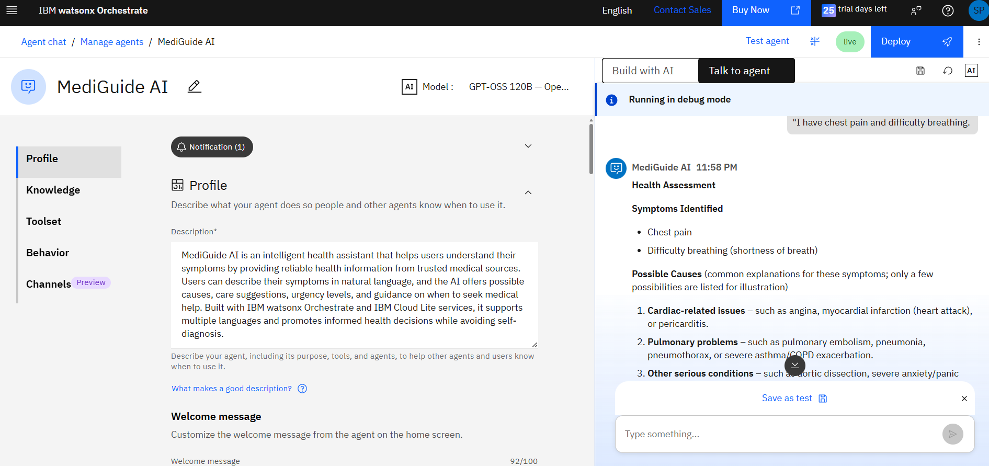
Result

Slide 12
Git Hub Link
Github URL –https://github.com/Shivapillai057/MediGuide-AI-Agentic-Health-Symptom-Checker
·
·
·

Slide 13
Future Scope
1.Integration with Wearables & Health Devices –
The system can be integrated with smartwatches and fitness trackers to collect real-time data such as steps, calories burned, heart rate, and sleep patterns. This will enable the Nutrition Agent to provide more accurate and dynamic diet recommendations based on actual user activity and health metrics.
2.AI-Powered Voice Assistant & Multilingual Support –
Enhancing the system with a voice-enabled assistant and support for multiple languages will improve accessibility. Users can interact naturally in their preferred language, making the solution more inclusive and suitable for diverse populations, especially in regions with varied linguistic backgrounds.
·
·
·

Slide 14


